Slide 1
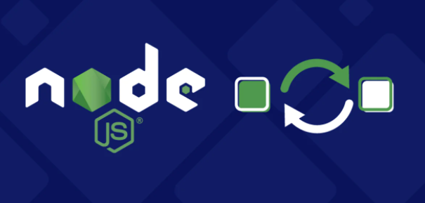
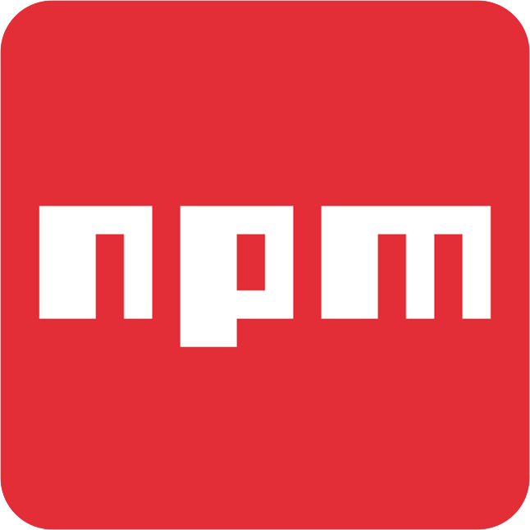
Node JS and NPM

Slide 2
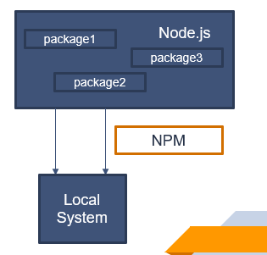
Node JS :
Node is a server side cross platform (runtime environment) build on google chrome V8 engine for building fast and scalable n/w applications
Node is basically a collection of packages
Based on our requirement we can install which ever package we want to work with
Just like we have NPM which is a node package manager for web based application, we also have other managers like maven etc.
Step 1 : Download Node JS in local : https://nodejs.org/en/
Step 2 : Check Node JS version : node –v

Slide 3
NPM :
Node Package Manager
NPM is an interface to Node Js, a way of communicating with Node JS
Official website for reference : https://www.npmjs.com/
(contains list of all packages and modules available on the Node JS)
We don’t have to install NPM separately, once we install Node JS it will automatically be installed in the local
CLI to interact with Node JS : npm install ----

Slide 4
A TIMELINE ALWAYS WORKS WELL
DAY 1
DAY 3
DAY 2
DAY 4
Jupiter is the biggest planet
Venus has a nice name
Earth is where we live on
Mars is a cold place

